Slide 1
LITTERATURE REVIEW

Slide 2
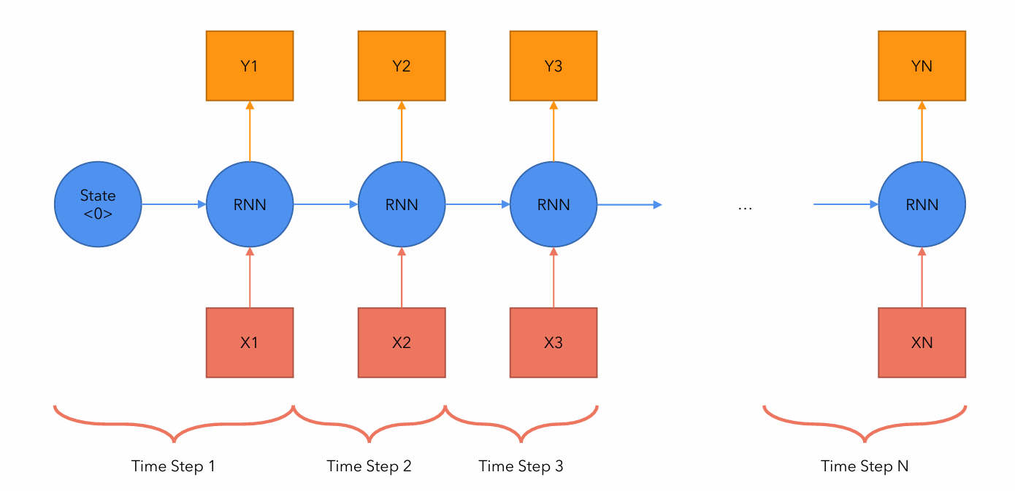
Paper 1: Attention all you need
Recurrent Neural Networks (RNN)
Problems with RNN (among others)
Slow computation for long sequences
Vanishing or exploding gradients
Difficulty in accessing information from long time ago

Slide 3
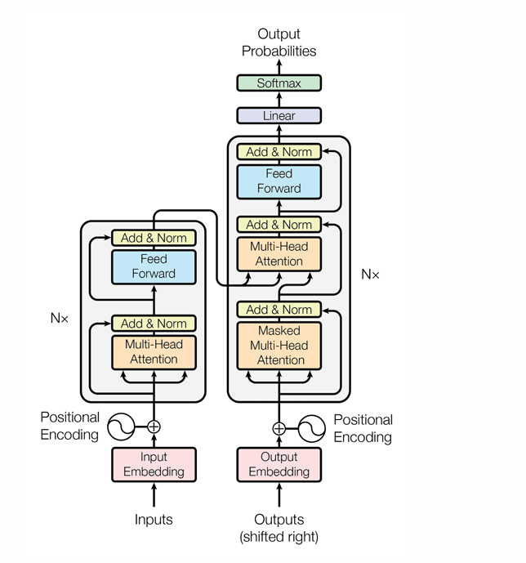
Paper 1: Attention all you need
Transformer

Slide 4
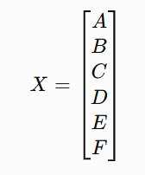
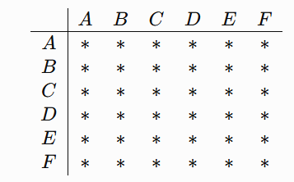


Paper 1: Attention all you need
Notations
Input matrix (sequence, dmodel)

Slide 5
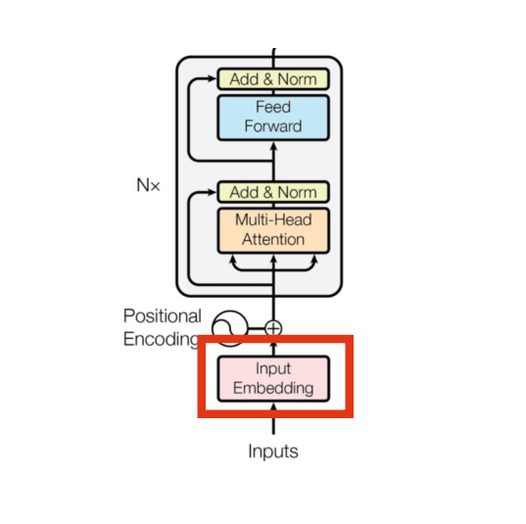
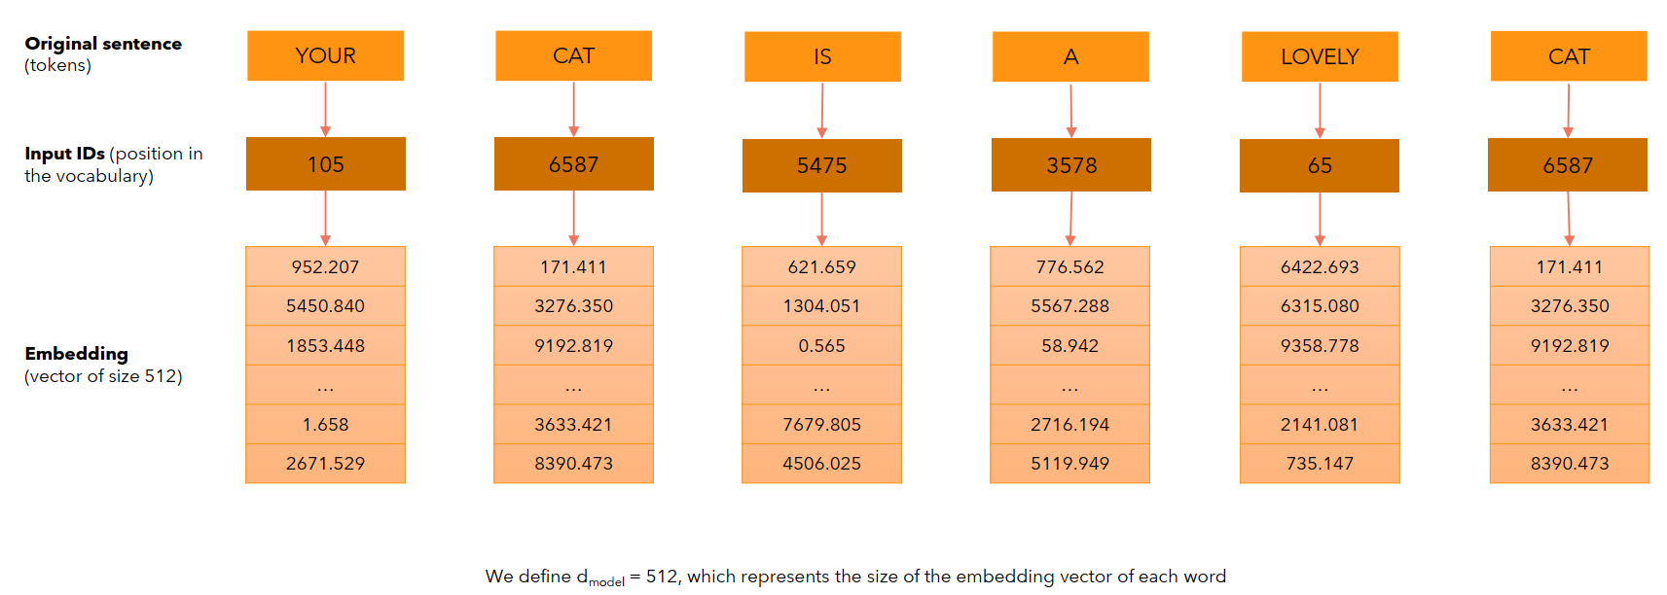
Paper 1: Attention all you need
Encoder
What is an input embedding?

Slide 6
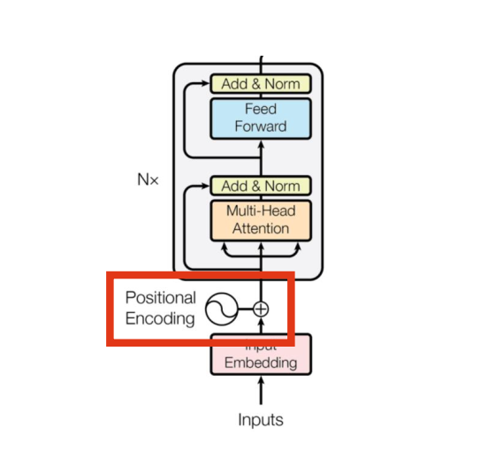
Paper 1: Attention all you need
Encoder
What is positional encoding?
• We want each word to carry some information about its position in the sentence.
• We want the model to treat words that appear close to each other as “close” and words that are
distant as “distant”.
• We want the positional encoding to represent a pattern that can be learned by the model.

Slide 7
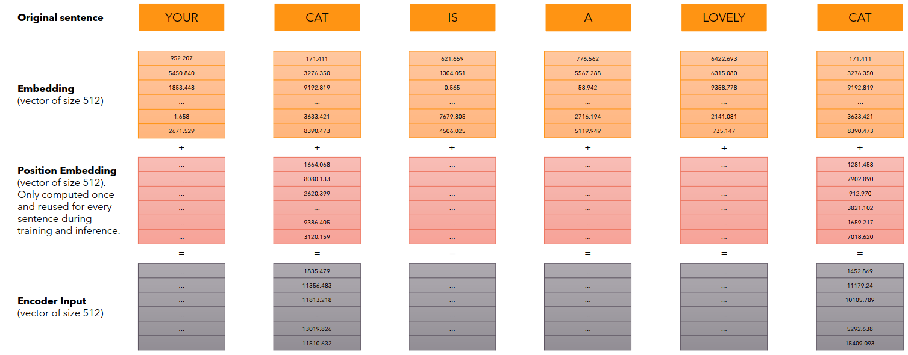





Paper 1: Attention all you need
What is positional encoding?

Slide 8
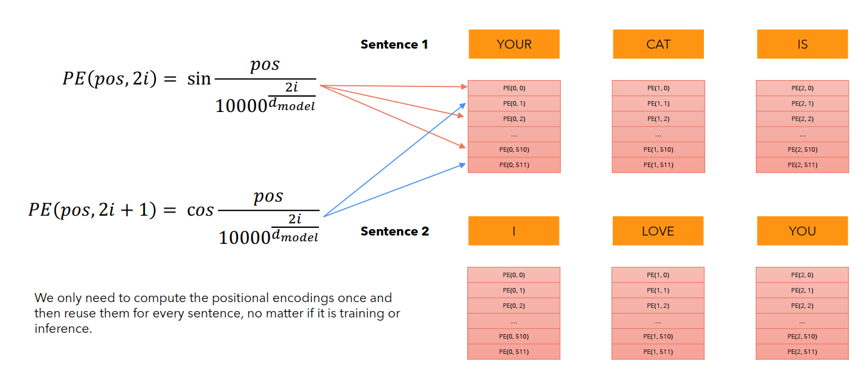
Paper 1: Attention all you need
What is positional encoding?

Slide 9

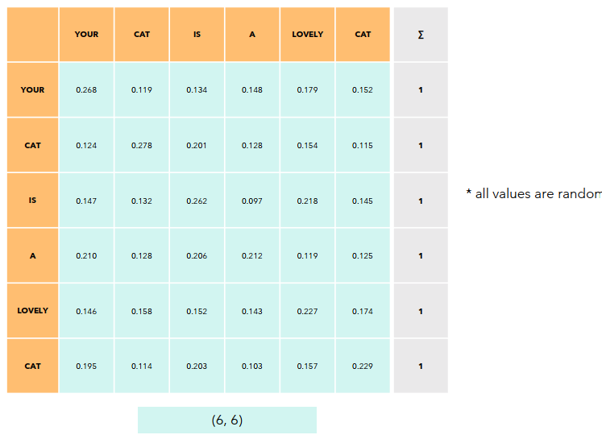
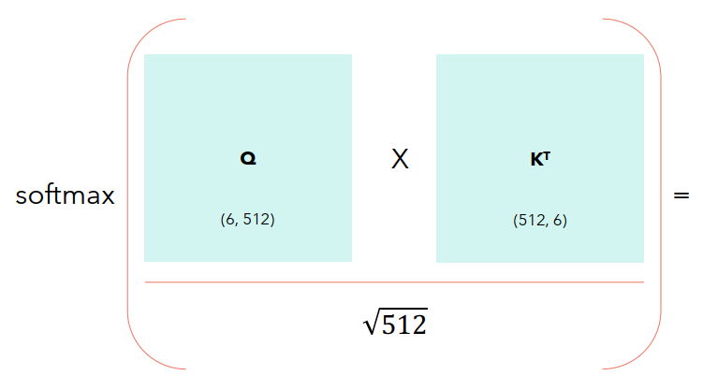
Paper 1: Attention all you need
What is Self-Attention?
Self-Attention allows the model to relate words to each other.
In this simple case we consider the sequence length seq = 6 and dmodel = dk= 512.
The matrices Q, K and V are just the input sentence.
* for simplicity, considered only one head, which makes dmodel = dk.

Slide 10
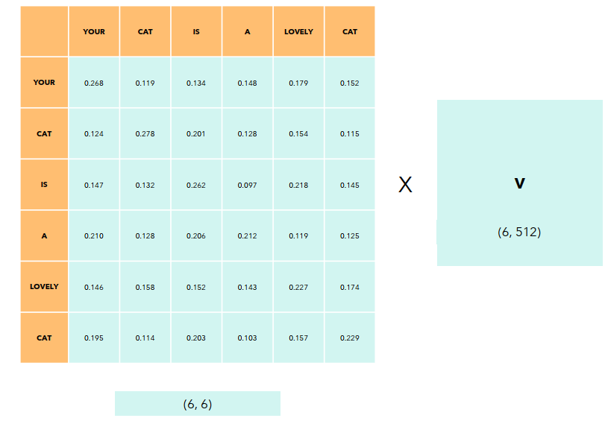
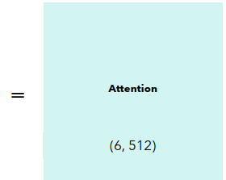
Paper 1: Attention all you need
How to compute Self-Attention?
Each row in this matrix captures not only the meaning (given by the embedding) or the position in the sentence (represented by the positional encodings) but also each word’s interaction with other words.

Slide 11
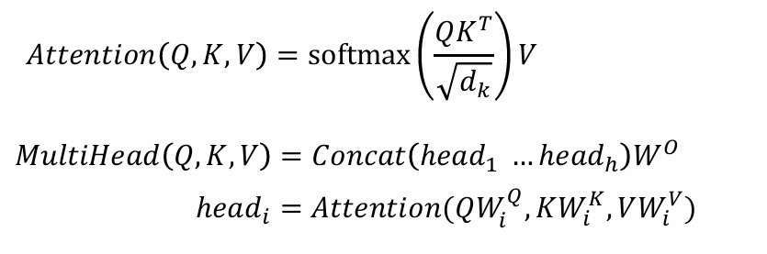
Paper 1: Attention all you need
Multi-head Attention

Slide 12
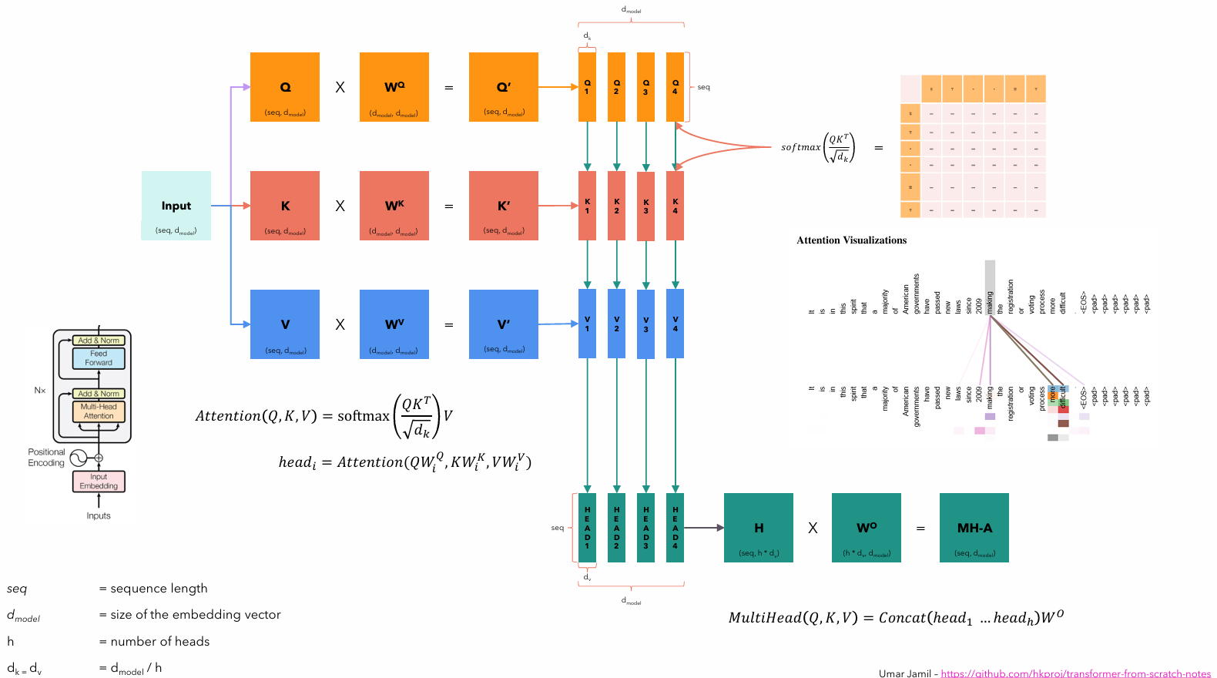
Paper 1: Attention all you need

Slide 13
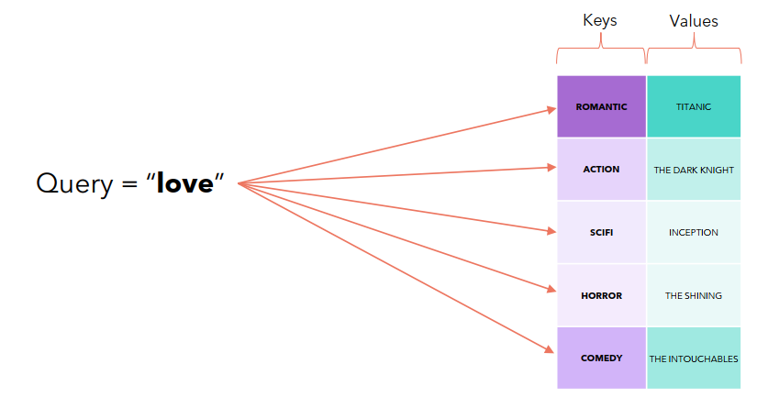
Paper 1: Attention all you need
Why query, keys and values?

Slide 14
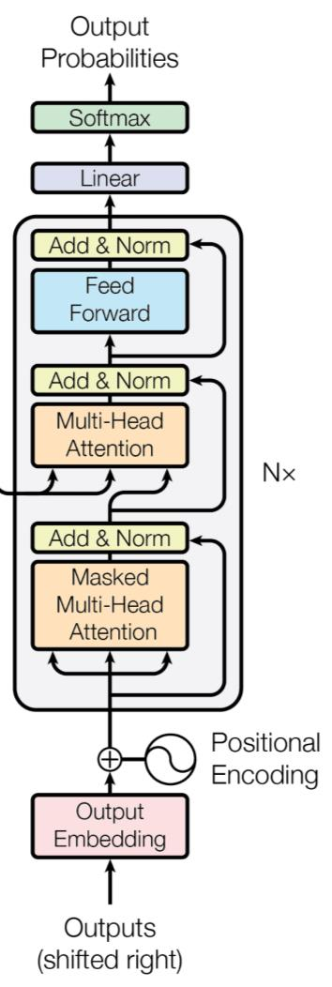
Paper 1: Attention all you need
Decoder

Slide 15
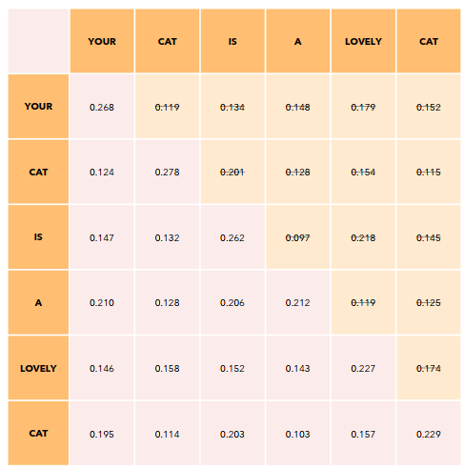
Paper 1: Attention all you need
What is Masked Multi-Head Attention?
Our goal is to make the model causal: it means the output at a certain position can only depend on the words on the previous positions. The model must not be able to see future words.

Slide 16
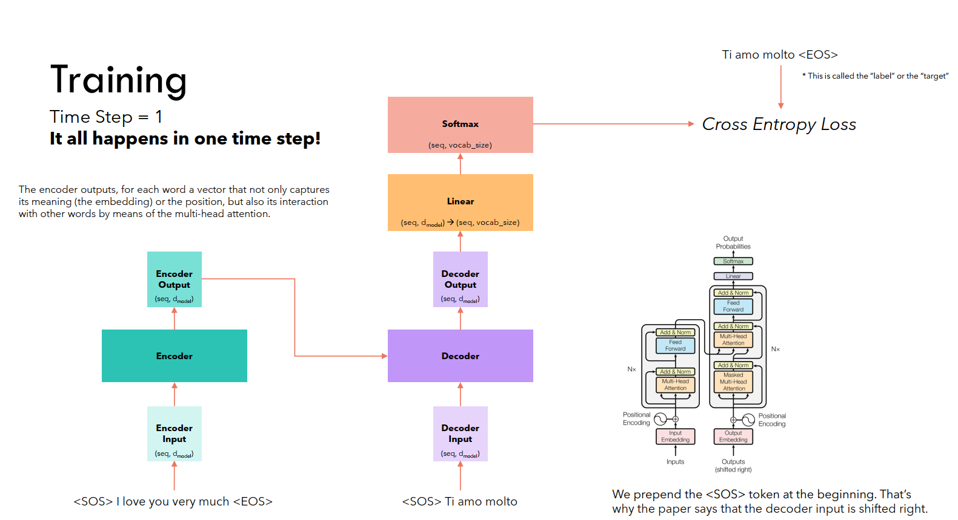
Paper 1: Attention all you need
Khối linear ánh xạ output decoder (embedding) sang kích thước của bộ từ vựng

Slide 17
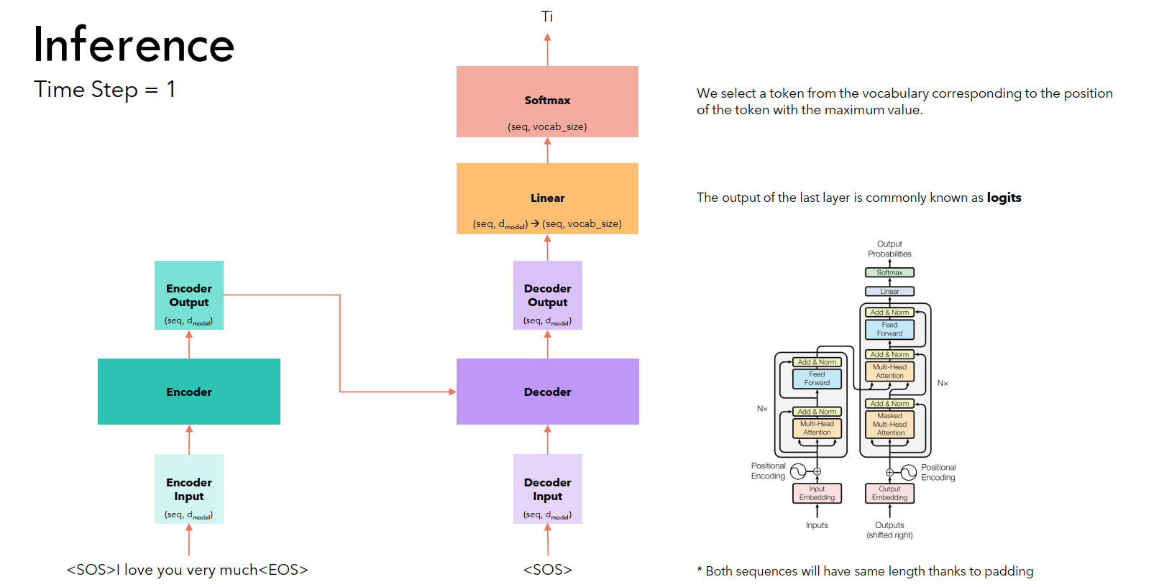
Paper 1: Attention all you need

Slide 18
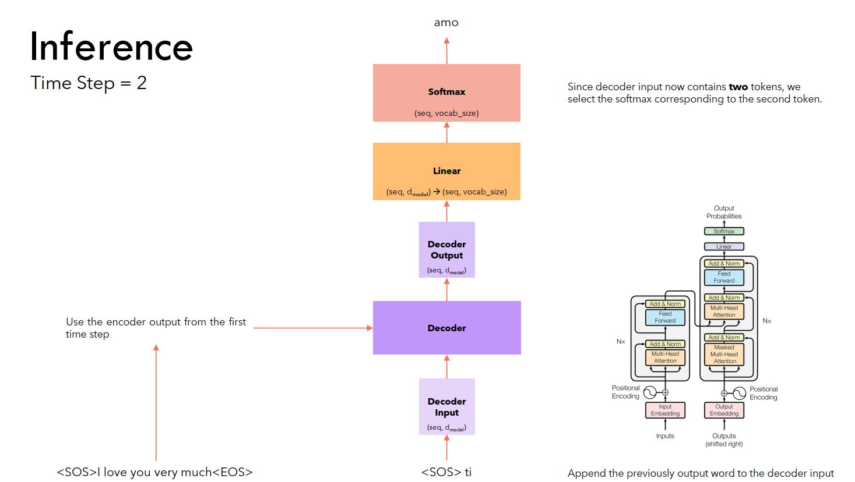
Paper 1: Attention all you need

Slide 19
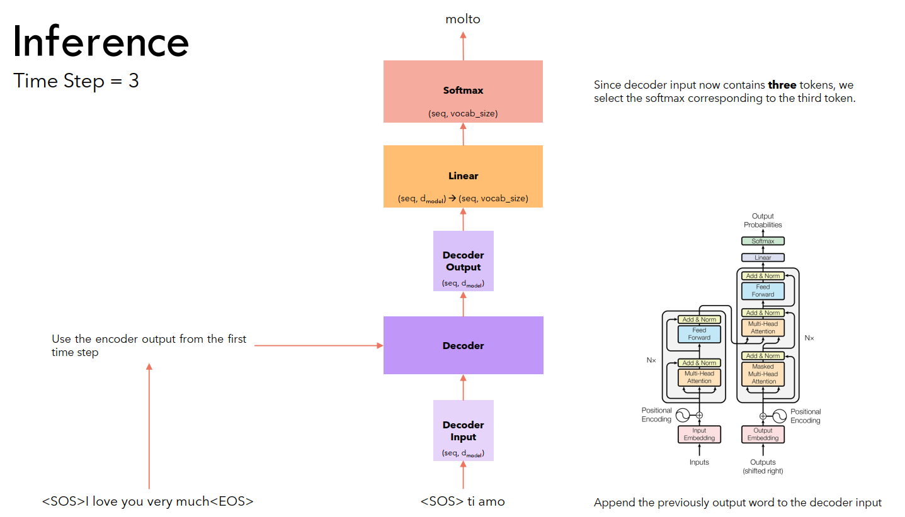
Paper 1: Attention all you need

Slide 20
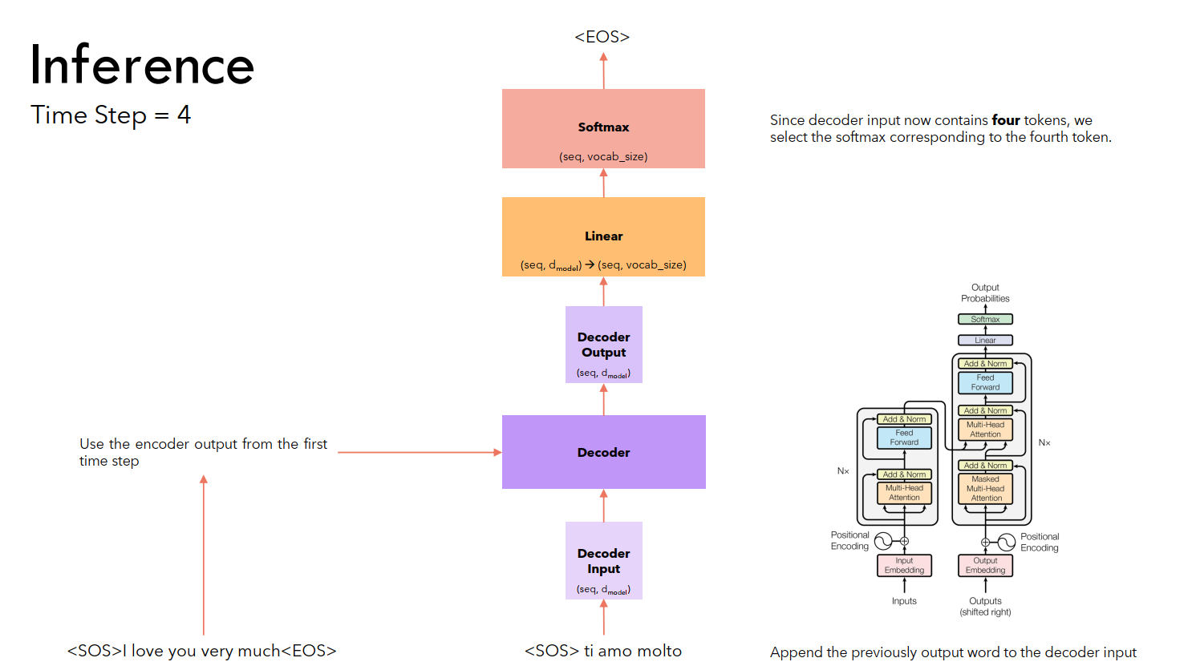
Paper 1: Attention all you need

Slide 21
Paper 1: Attention all you need

